Slide 1


CSA 1514 - CLOUD COMPUTING AND BIG DATA ANALYTICS
Cloud-based AI Driver Drowsiness Monitoring System Compared With Traditional Driver Alert Systems For Improved Road Safety And Real-time Monitoring
GUIDED BY:
PRESENTED BY:
Dr . C Govindasamy
Jaganathan E (192521146)
Dakshin S (192511431)
Yogeshwaran M (192524363)
Sravan Kumar Y(192472289)

Slide 2
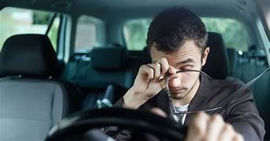
INTRODUCTION
Driver drowsiness is a major cause of road accidents and fatalities.
The Anti-Sleep Driver Monitoring System continuously monitors the driver's alertness.
Cameras and sensors detect signs of fatigue, such as eye closure and head movement.
Control system techniques process the data and compare it with predefined thresholds.
When drowsiness is detected, the system generates an alert to help prevent accidents.

Slide 3

OBJECTIVE
To detect driver drowsiness in real time using cameras and sensors.
To continuously monitor the driver's eye movements and facial expressions.
To apply control system principles for analyzing driver alertness.
To generate timely alerts when signs of fatigue are detected.
To improve road safety and reduce accidents caused by driver sleepiness.

Slide 4
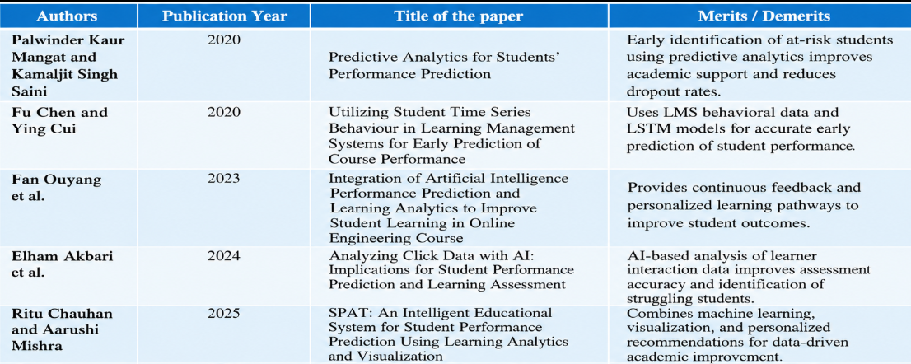
LITERATURE REVIEW

Slide 5

ALGORITHM
Start
Capture live video from the driver's camera and detect the face, eyes, and mouth using facial landmarks.
Calculate facial features such as Eye Aspect Ratio (EAR), Mouth Aspect Ratio (MAR), and eye-closure duration.
Apply CNN + LSTM to analyze facial features and identify drowsiness patterns.
If drowsiness exceeds the threshold → Trigger alarm and send a real-time alert to the cloud server.
Repeat the monitoring process continuously → Stop when the system is switched off.

Slide 6
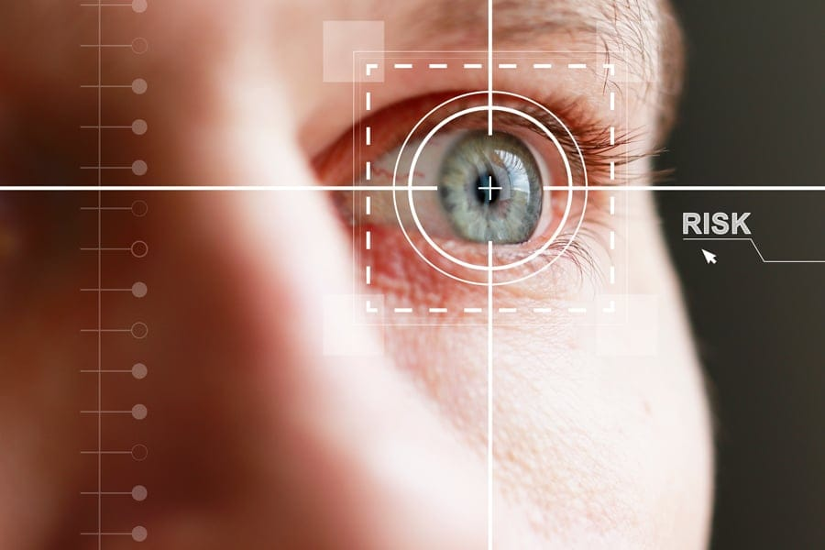
MODULE 1 - DRIVER MONITORING AND DATA ACQUISITION
Real-time video capture using an in-vehicle camera.
Driver face detection from the captured video frames.
Facial feature extraction such as eyes, mouth, and head position.
Drowsiness-related data collection including EAR, MAR, blinking, and yawning.
Preprocessing and transmission of the collected data to the AI-based detection module.

Slide 7
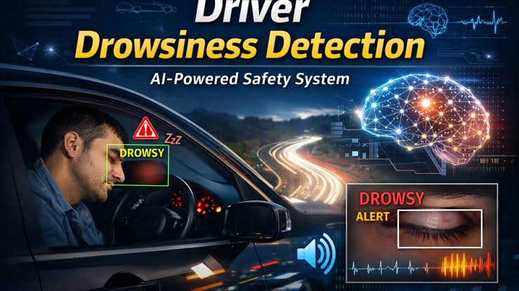
MODULE 2-DROWSINES DETECTION & ALERT
Process the captured images using image-processing techniques.
Analyse eye closure duration and blinking patterns.
Compare measured values with predefined threshold values.
Analyze continuous behavior using the CNN–LSTM algorithm.
Generate a decision signal for activating the warning system when drowsiness is detected.

Slide 8
MODULE 3 - ALERT GENERATION AND SAFETY RESPONSE
Activate a buzzer, voice alert, or vibration when drowsiness is detected.
Provide immediate warning signals to regain driver attention.
Continuously monitor the driver's response after the alert.
Reset the warning system when the driver becomes alert again.
Improve vehicle safety by preventing fatigue-related accidents.

Slide 9
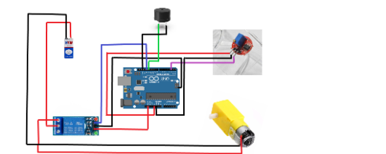
BLOCK DIAGRAM

Slide 10
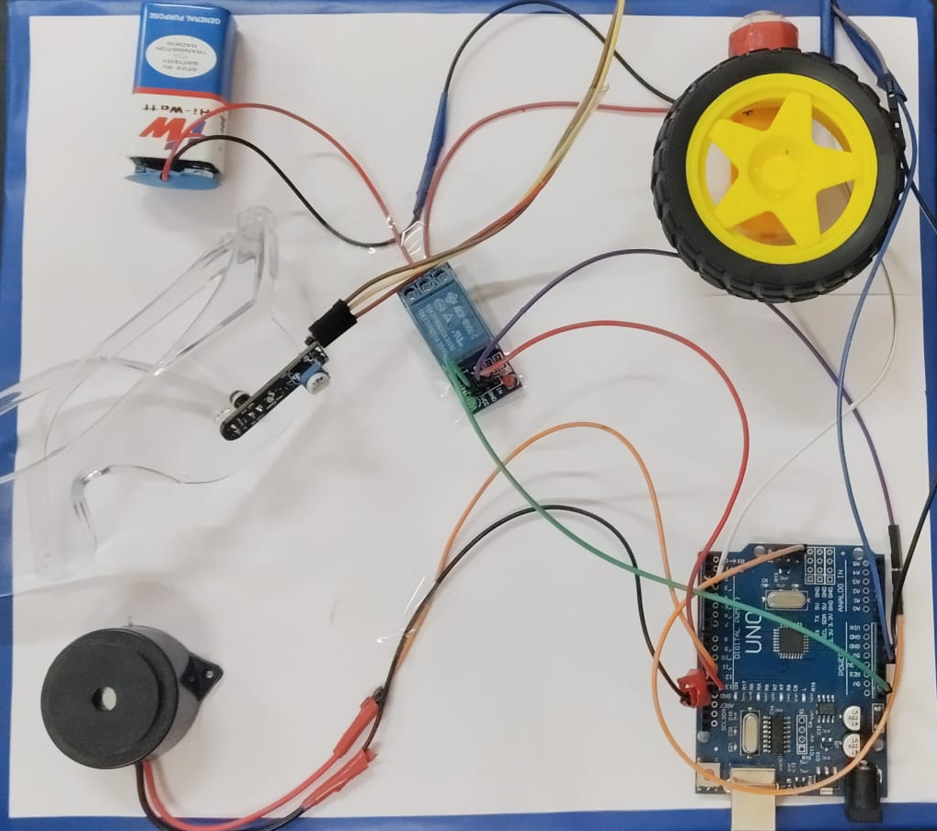
RESULT
Accurate detection of driver drowsiness in real time.
Early identification of prolonged eye closure and yawning.
Fast response through immediate alert generation.
Reduced risk of accidents caused by driver fatigue.
Improved road safety through continuous driver monitoring.

Slide 11

CONCLUSION
The proposed cloud-based AI driver drowsiness monitoring system provides real-time and continuous driver monitoring.
The CNN–LSTM algorithm effectively detects drowsiness using eye closure, blinking, yawning, and facial features.
Immediate audio/visual alerts help warn drivers before dangerous situations occur.
Cloud connectivity enables real-time monitoring, data storage, and remote access.
Compared with traditional alert systems, the proposed system provides better monitoring, faster

Slide 12
REFERENCE
T. Soukupová and J. Čech, Real-Time Eye Blink Detection Using Facial Landmarks, 2016.
Y. Zhang, M. Abdel-Mottaleb, and H. Lin, Driver Fatigue Detection Using Eye State Analysis, IEEE Conference.
S. Ji, W. Xu, M. Yang, K. Yu, 3D Convolutional Neural Networks for Human Action Recognition, IEEE Trans.
A. Jain and T. K. Gandhi, Real Time Driver Drowsiness Detection System Using Python, International Journal of Computer Applications.
J. F. Cohn et al., Estimating Drivers’ Alertness Using Facial Feature Tracking Algorithms, Transportation Research Record.
P. Viola and M. Jones, Rapid Object Detection Using a Boosted Cascade of Simple Features, CVPR 2001.

Slide 13


